Slide 1


Assessing the Efficacy of Spectrum-Aided Visual Enhancer (SAVE) in Skin Cancer Detection using Band Selection and Hyperspectral Imaging
Master of Science
Advisor: Prof. Hsiang-Chen Wang, Ph.D.
Student: Kalpana Nampelly
Student ID: 611445005
Advanced Institute of Manufacturing with Hi-Tech Innovations (AIM-HI)
National Chung Cheng University,
Min-Hsiung, Taiwan, 621301.

Slide 2
Contents
Introduction
Melanoma & Challenges
Methodology
Experimental Results and Discussion
Conclusions and Future Scope
Hyperspectral Imaging
SAVE
CNN

Slide 3
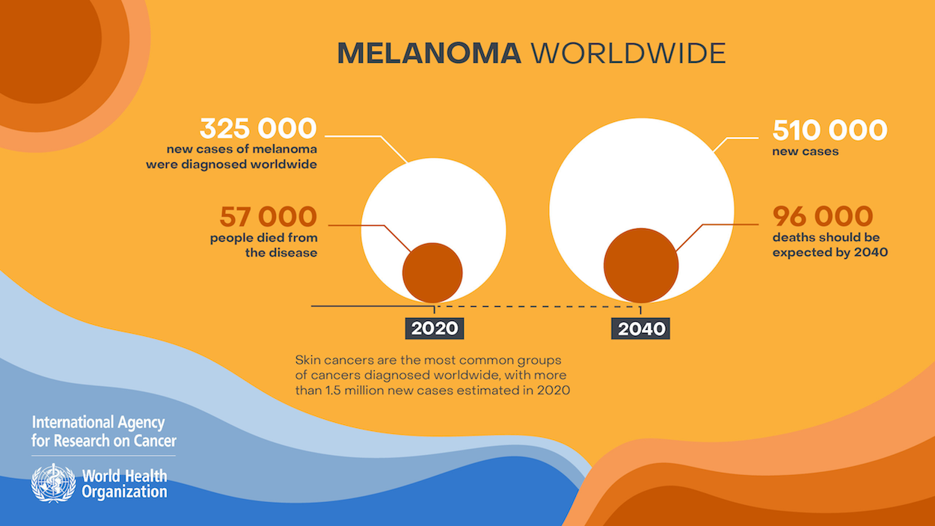
Introduction
Melanoma is the deadliest form of skin cancer
Early detection can save patients live
Traditional diagnostic methods time-consuming and require specialized expertise
Deep learning offers promising solution to this challenge.
Programming language (automated approach) enhances diagnostic accuracy and reduces the time and cost.
https://github.com/laurakoco/melanoma-detection-ml
https://github.com/kshitij-raj/Melanoma-Skin-Cancer-Detection
https://thepythoncode.com/article/skin-cancer-detection-using-tensorflow-in-python
Global burden of cutaneous melanoma in 2020 and projections to 2040 – IARC (who.int)

Slide 4
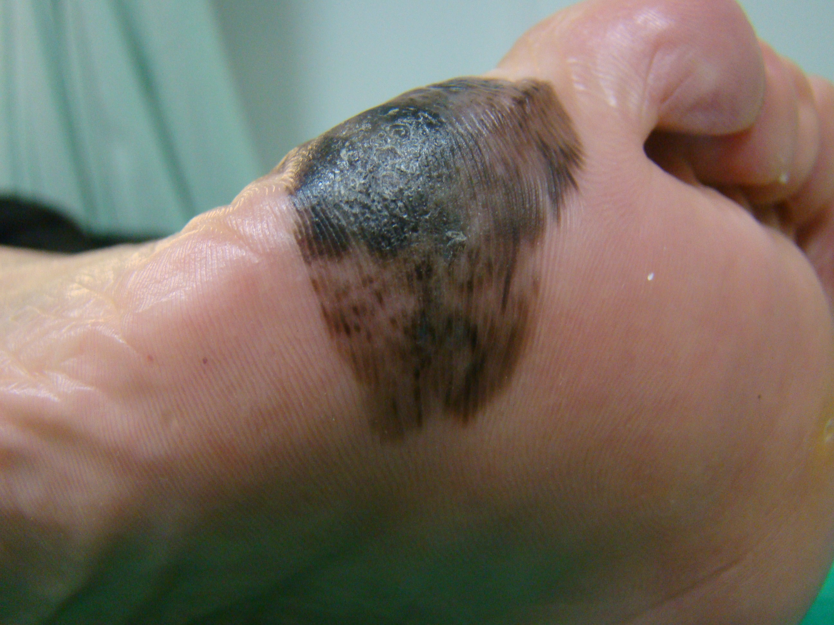
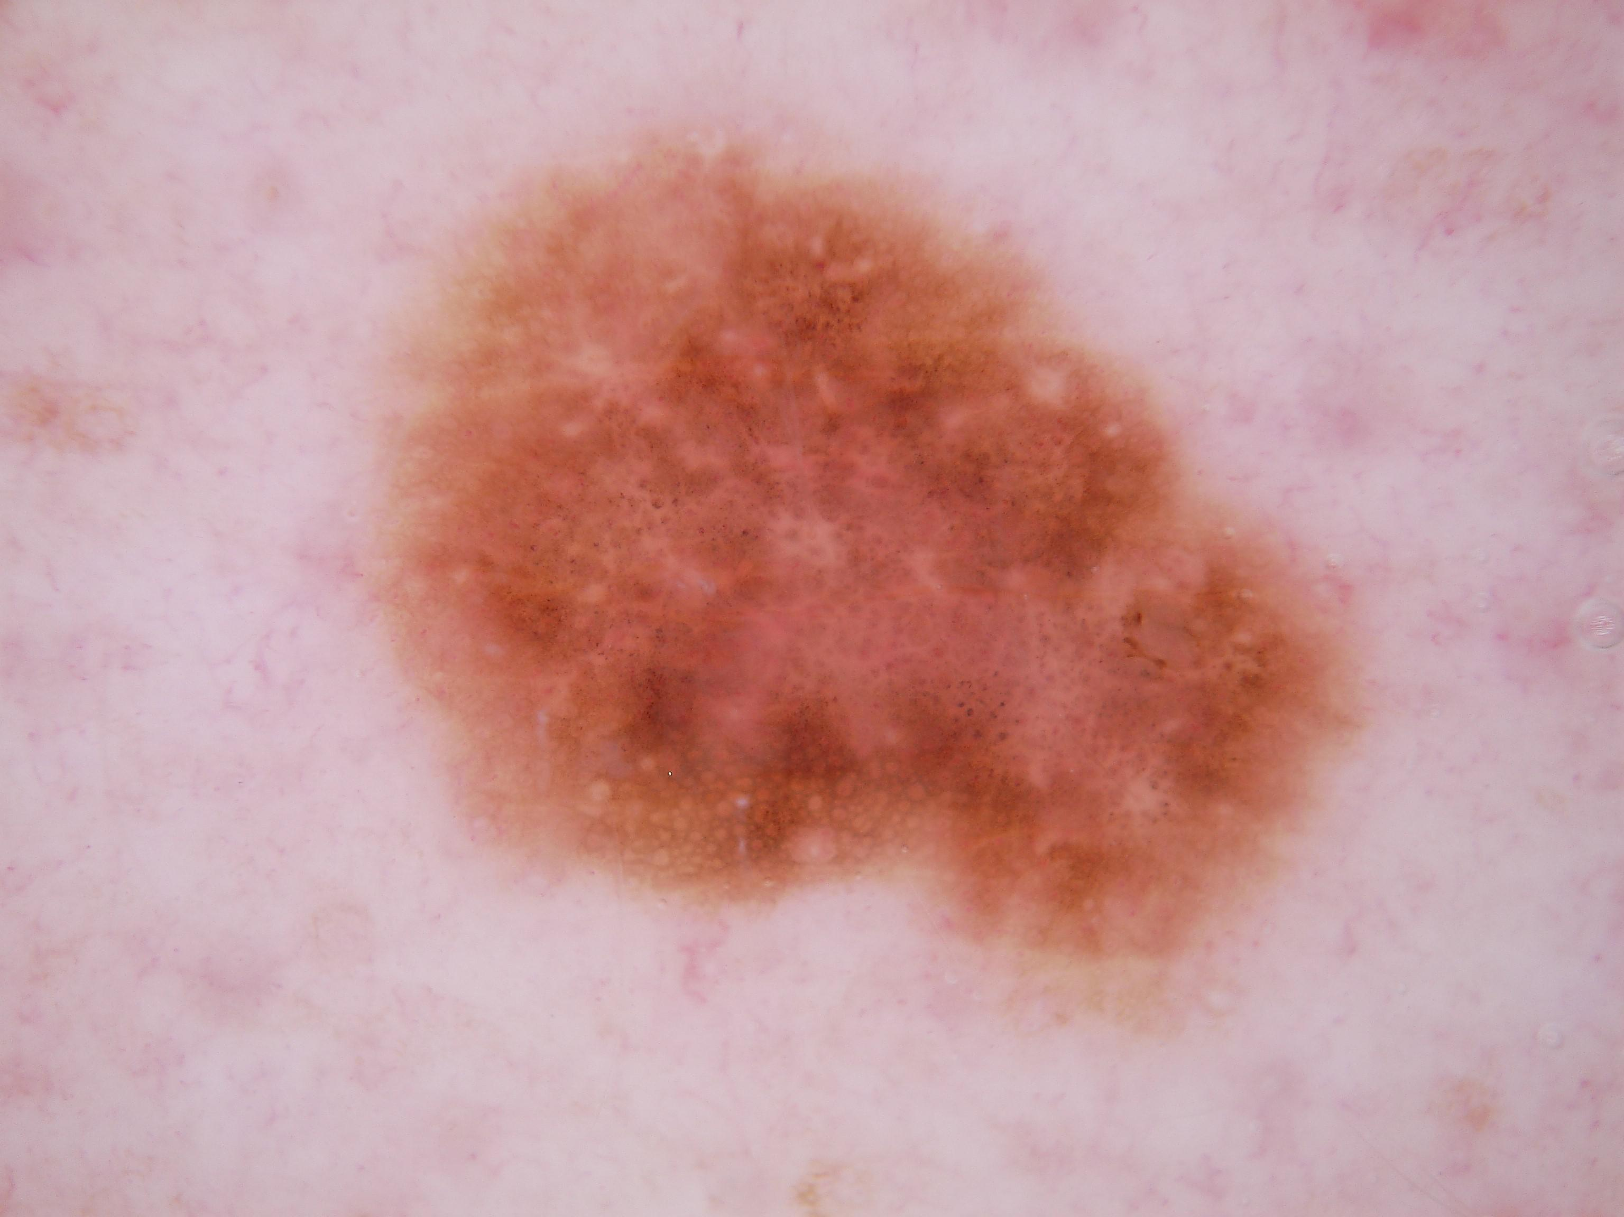
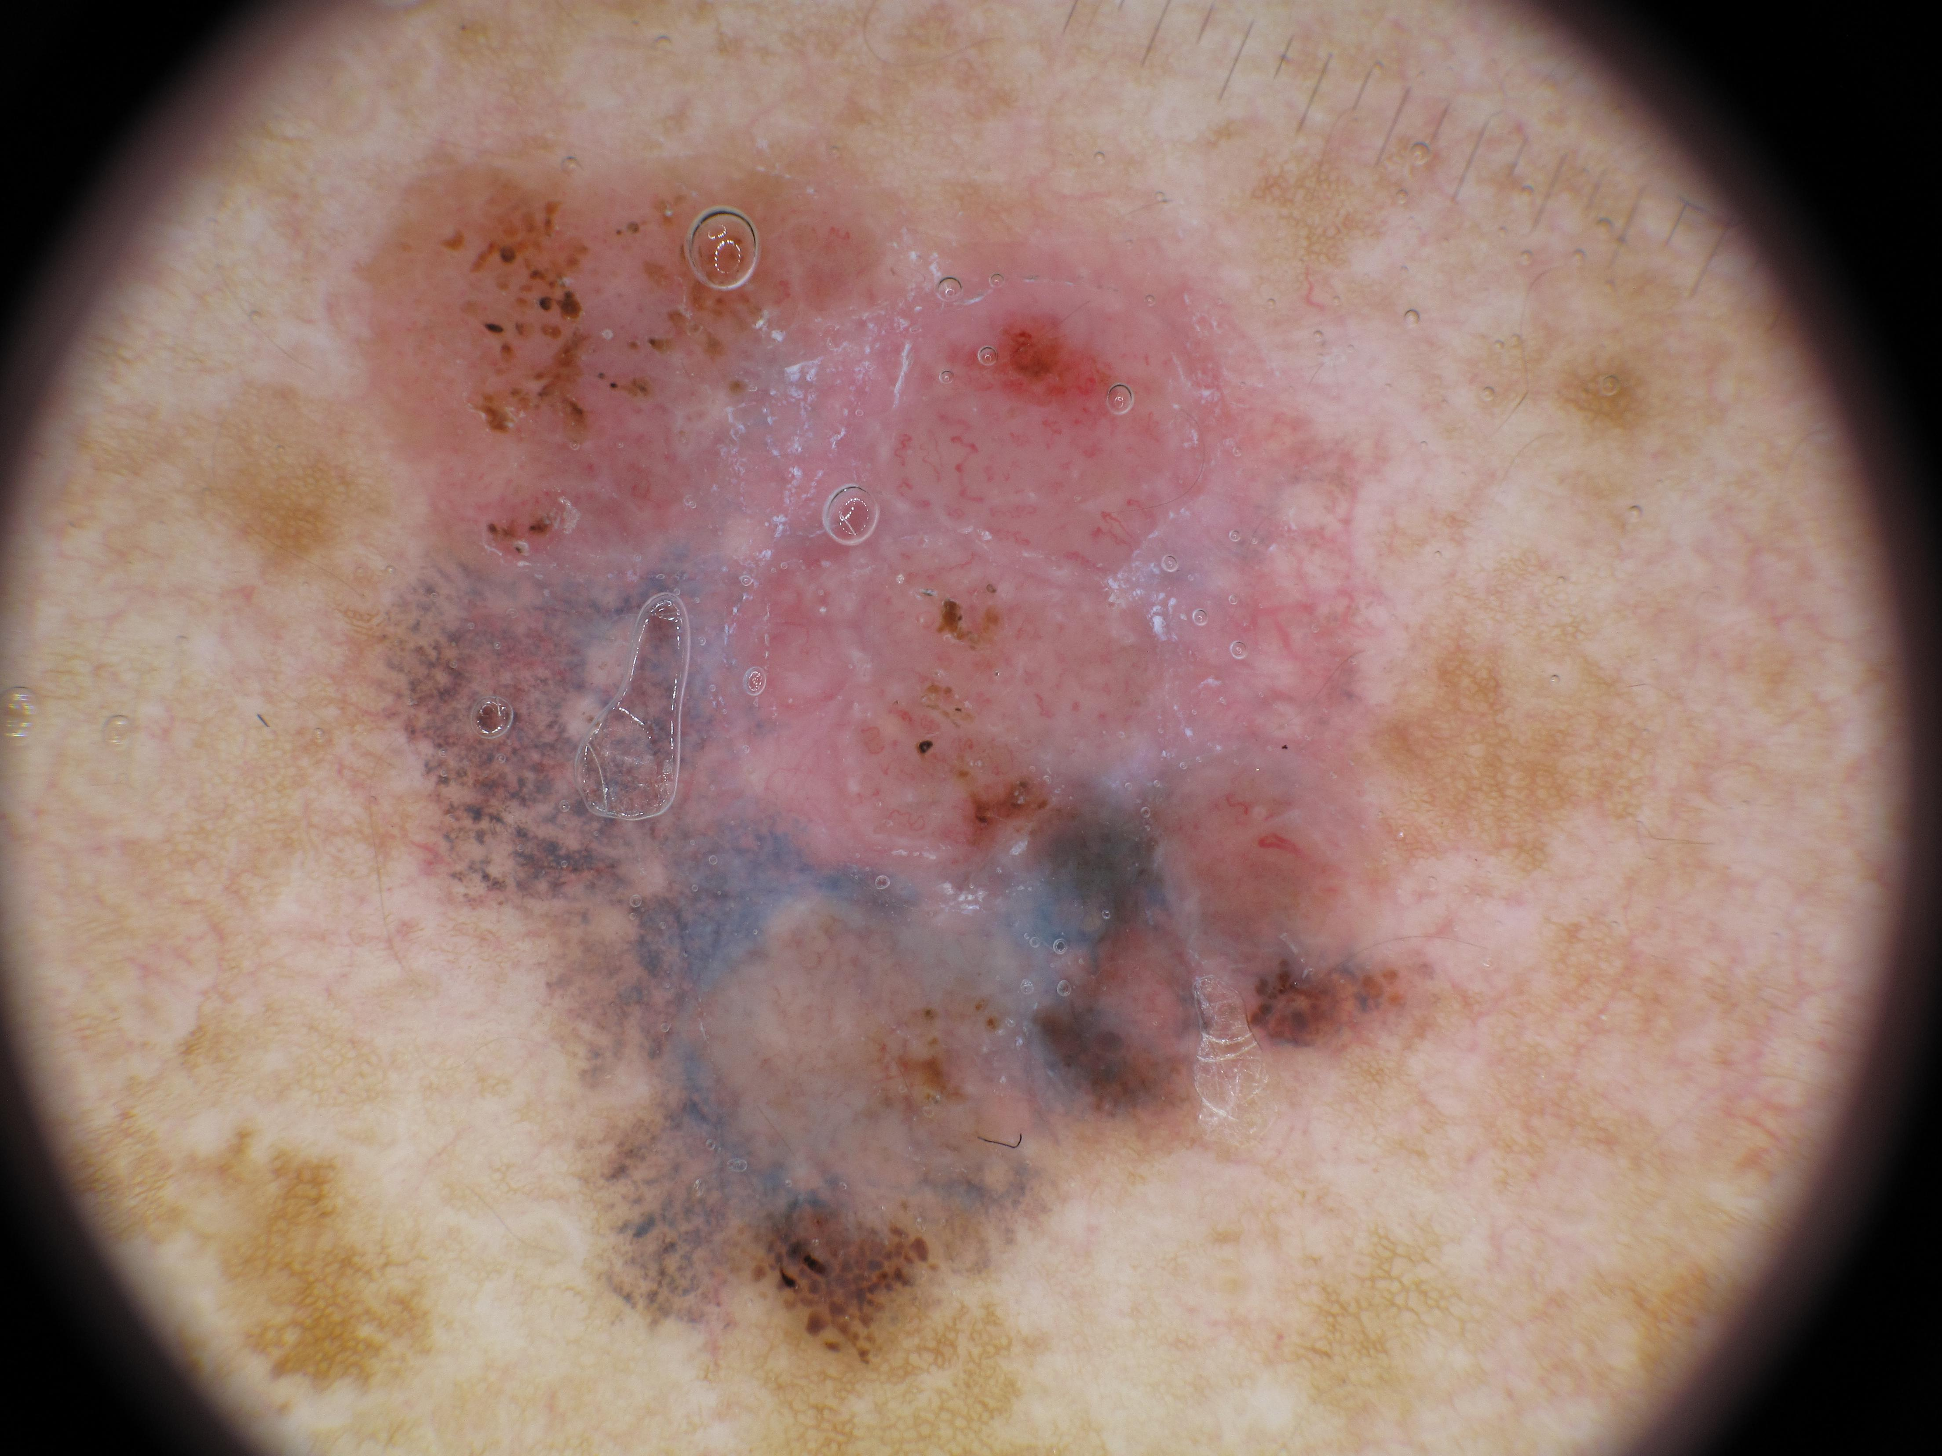
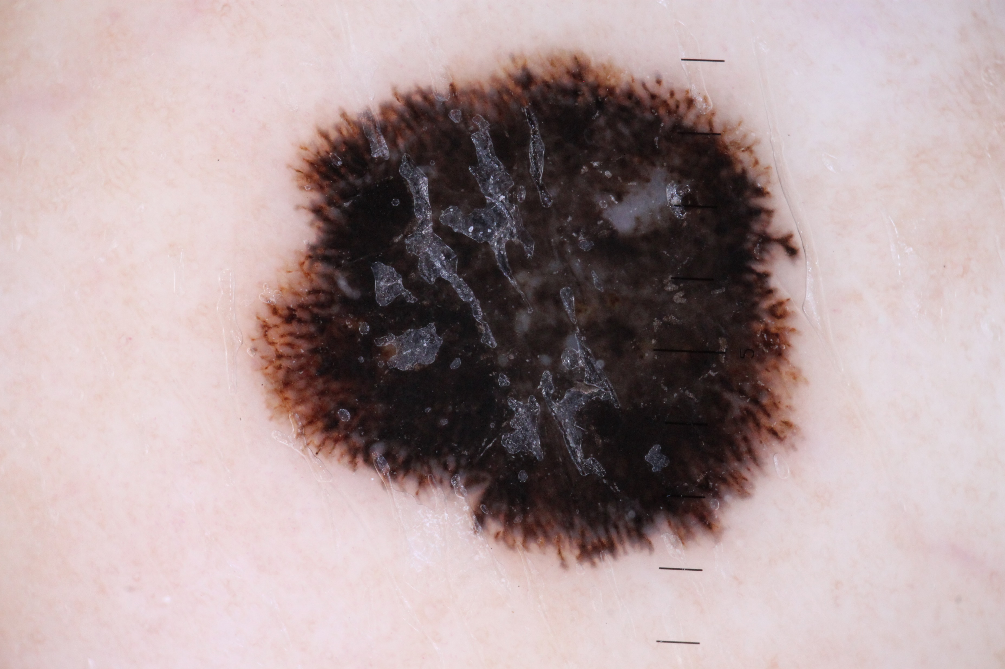
Melanoma types
Clinical Challenges:
Expertise required to detect
Time consuming diagnosis
Discriminating between benign and malignant skin lesions is challenging
Low detection accuracy with traditional methods
Acral Lentiginous Melanoma (ALM):
    Rare type
    Grows on palms, soles, under the nails
    More common in dark skin types
Melanoma In-Situ (MIS):
  early stage skin cancer
Nodular Melanoma (NM):
aggressive and rapid grown
appears like bump
D. Superficial Spreading Melanoma (SSM):
Spreads across the skin
Common melanoma
  Accounts 70% of all melanomas
Melanoma (cancer)
A
B
C
D
https://www.skincancer.org/skin-cancer-information/melanoma/types-of-melanoma
https://www.mayoclinic.org/diseases-conditions/melanoma/symptoms-causes/syc-20374884

Slide 5
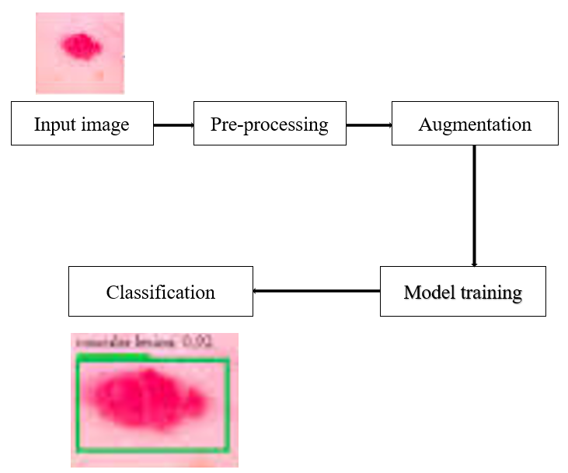
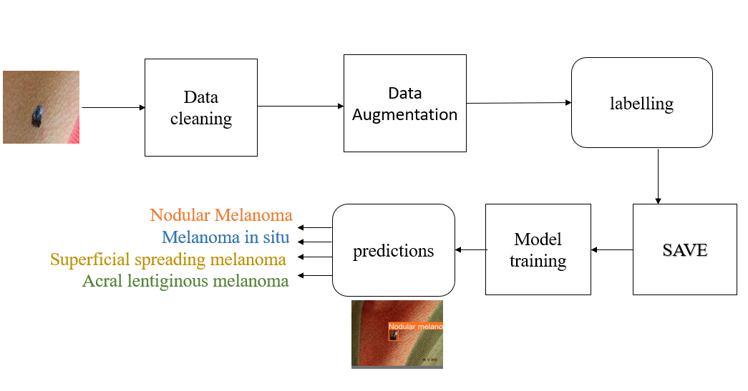
Research Outline
Previous models (4389 images)
Accurate but Less efficient
This Project (878 images)
Accurate & efficient
https://doi.org/10.1016/j.procs.2023.03.083

Slide 6
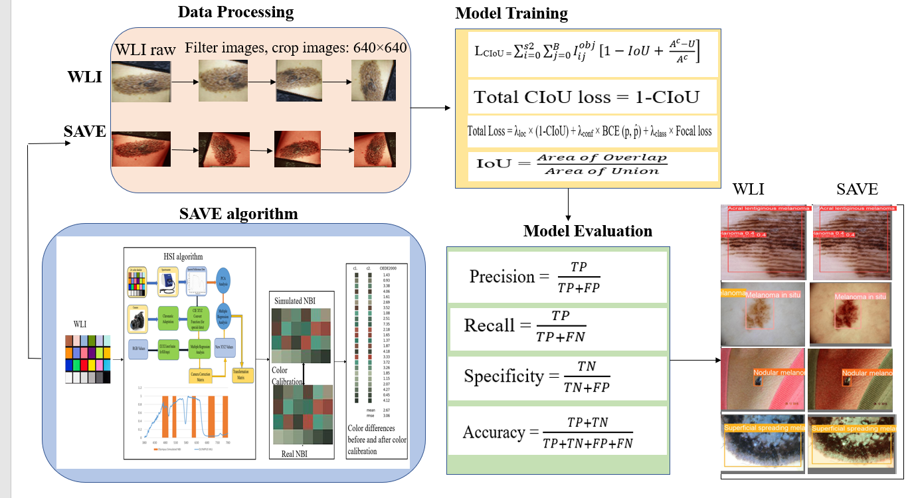
Methodology
An Overall flow diagram for this project

Slide 7
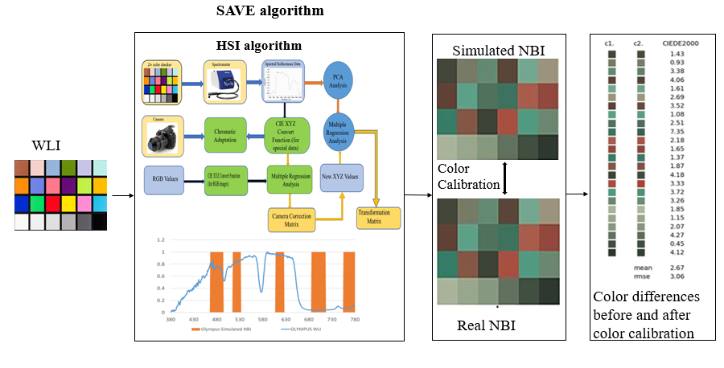
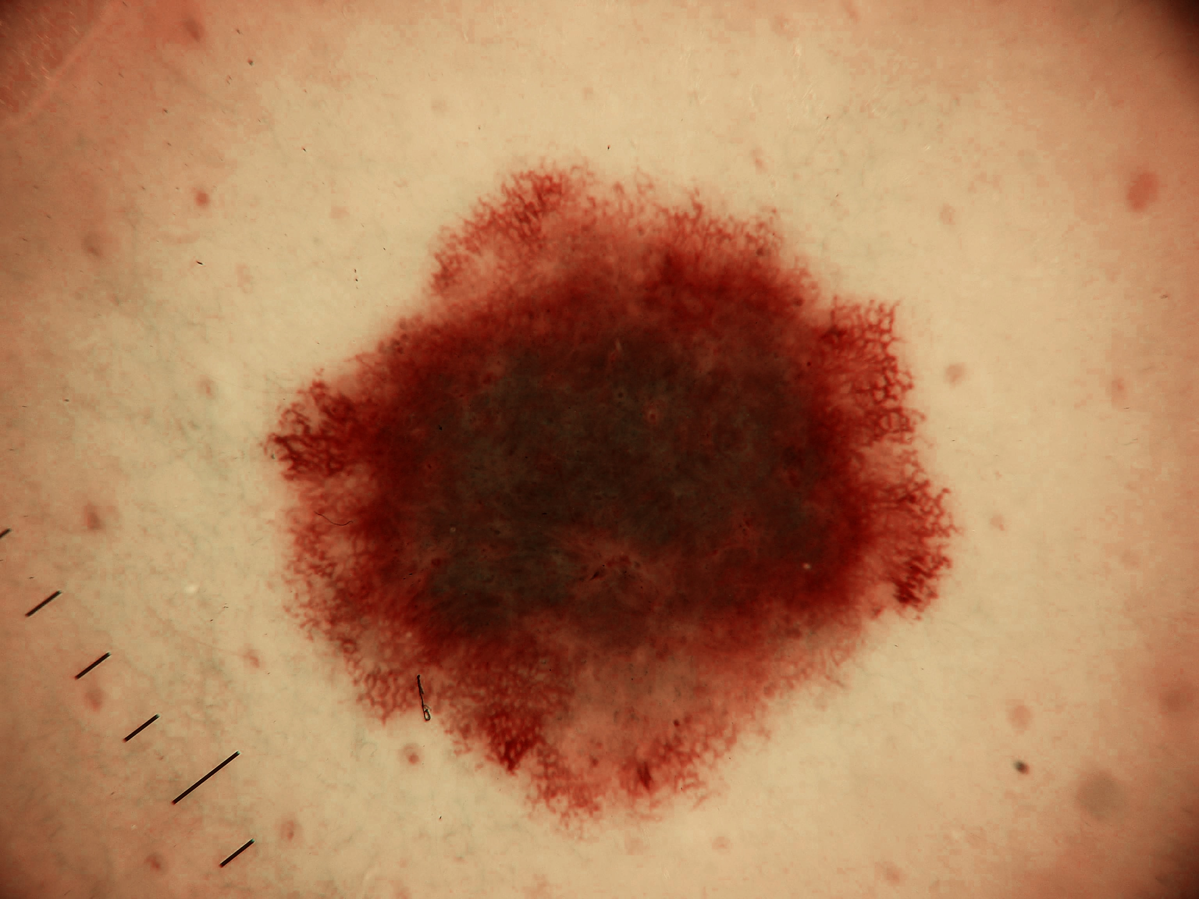
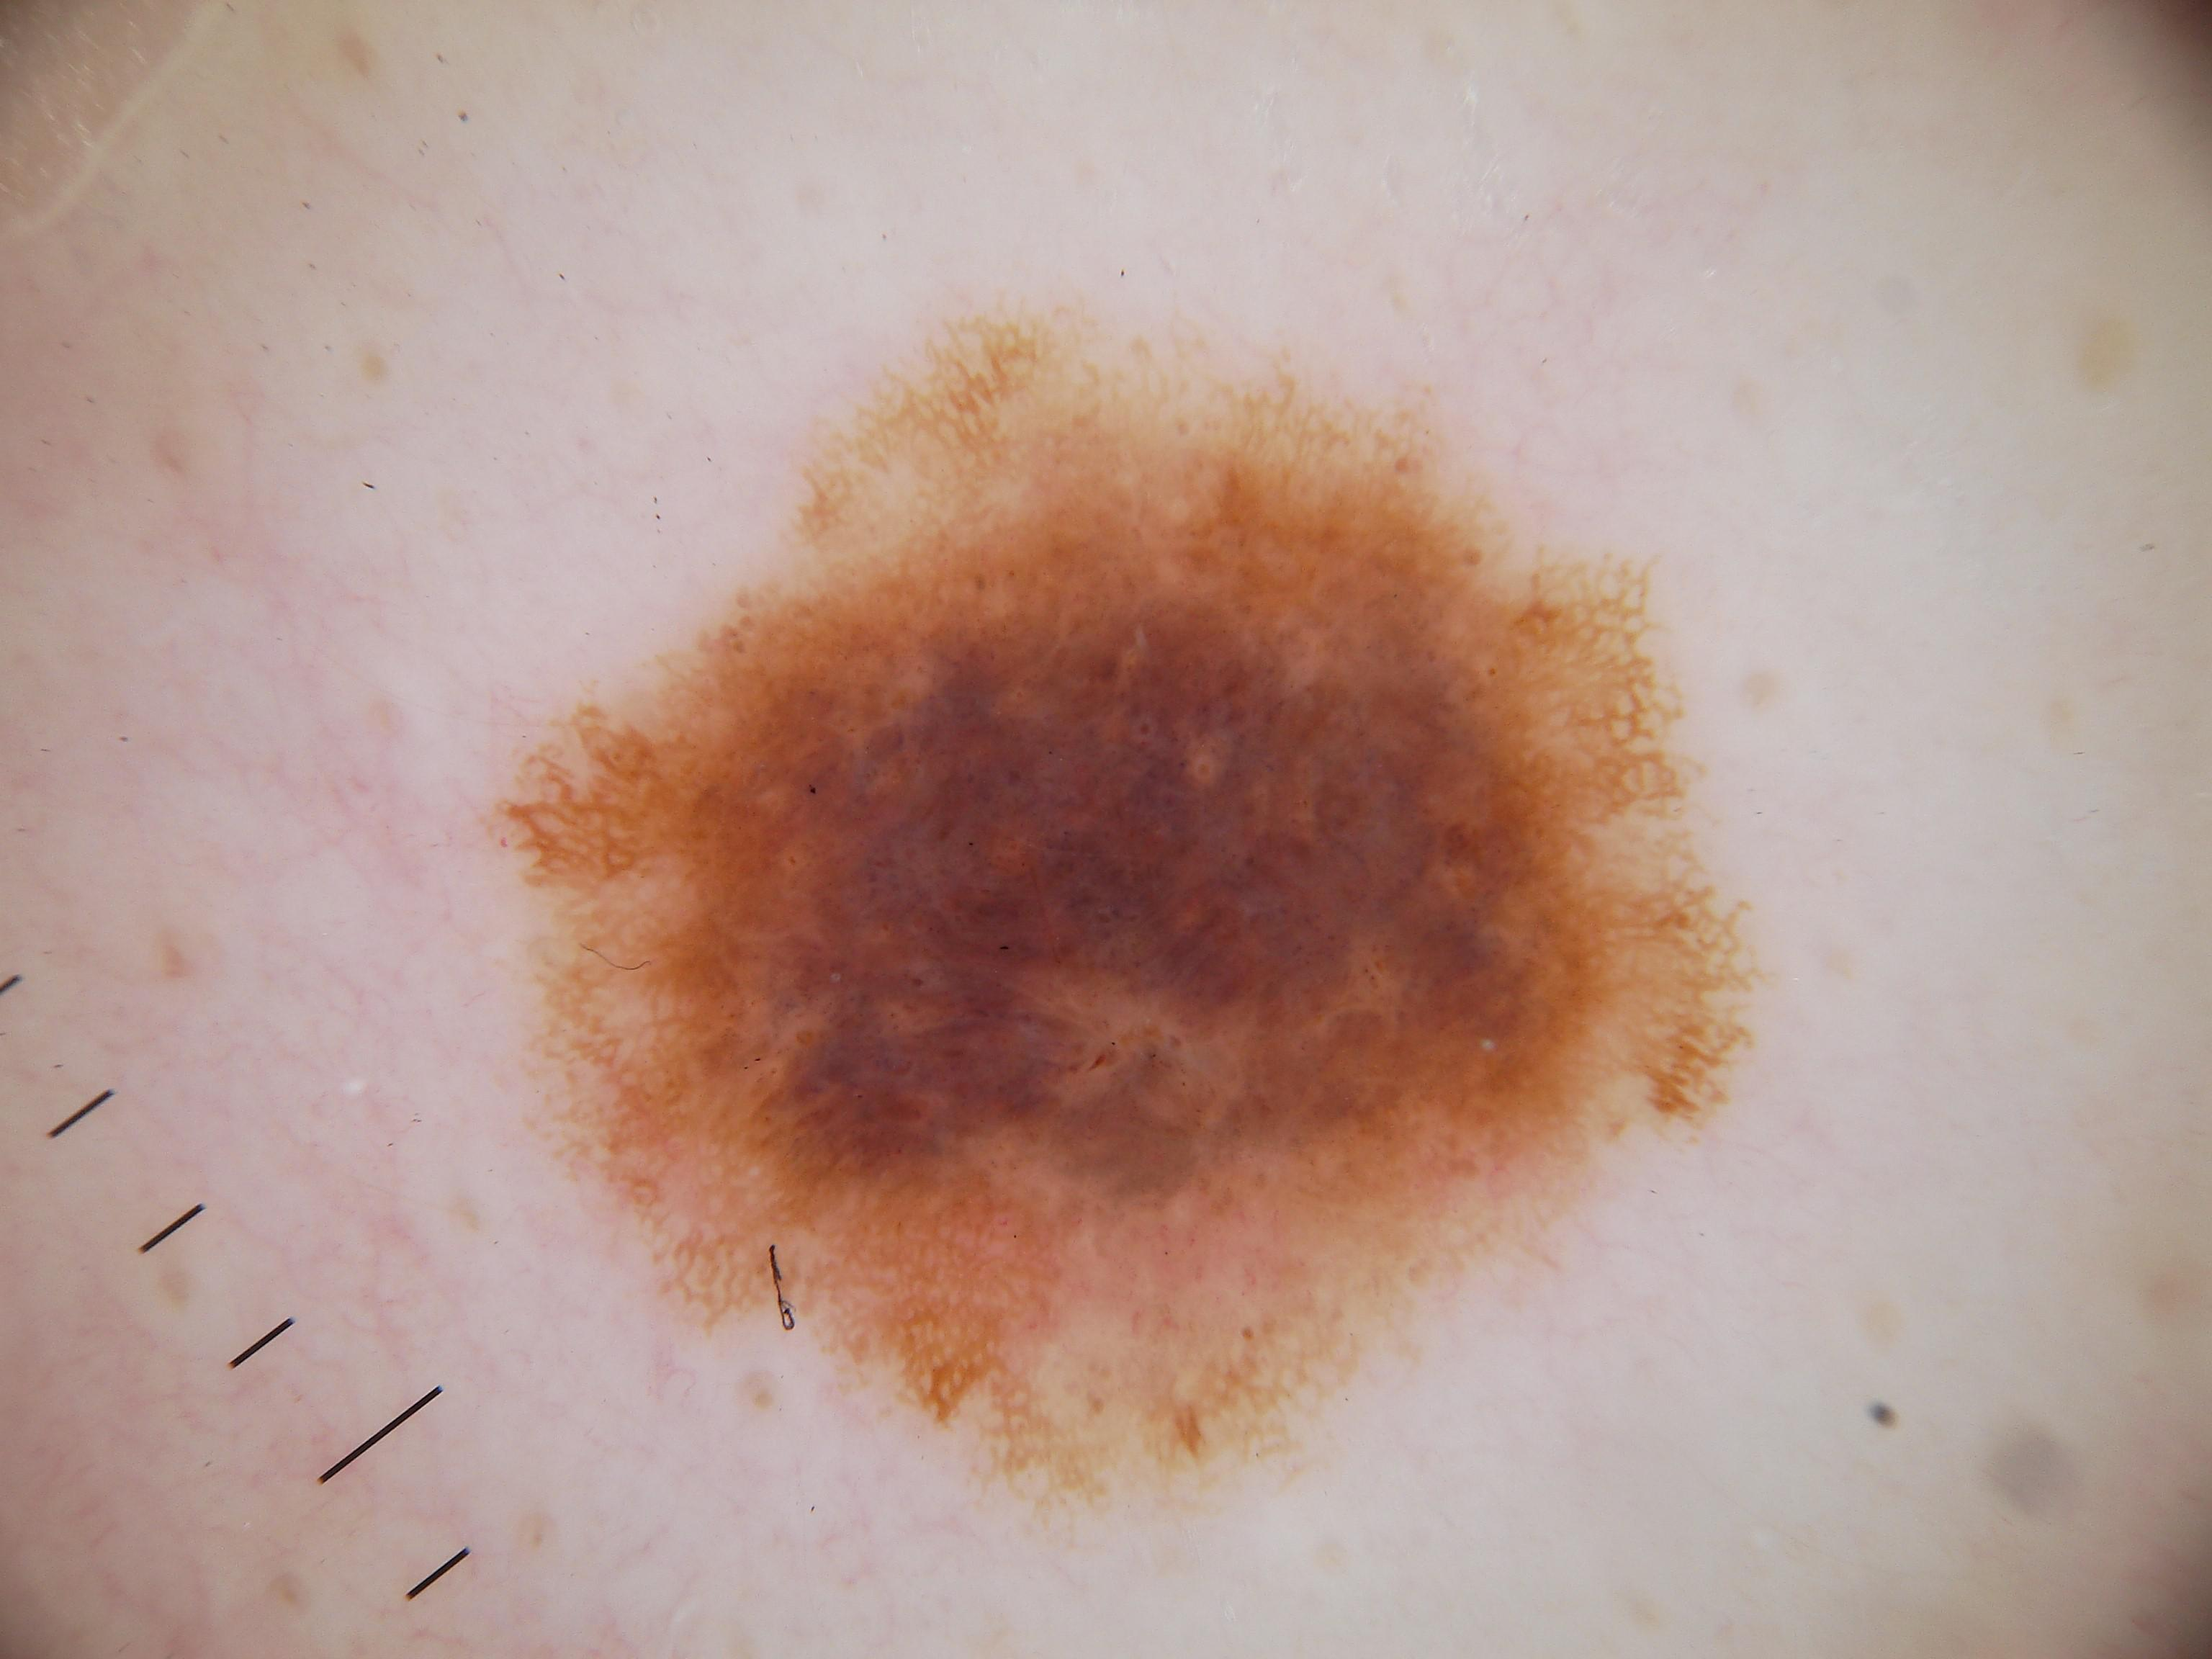
Flow of SAVE model
WLI
SAVE

Slide 8
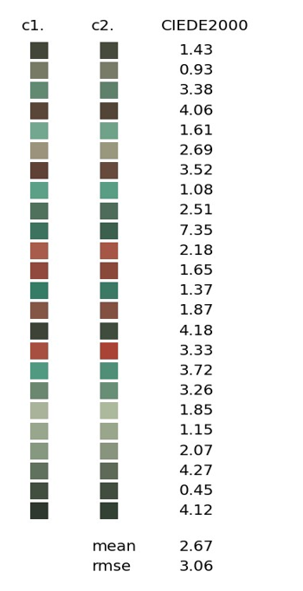
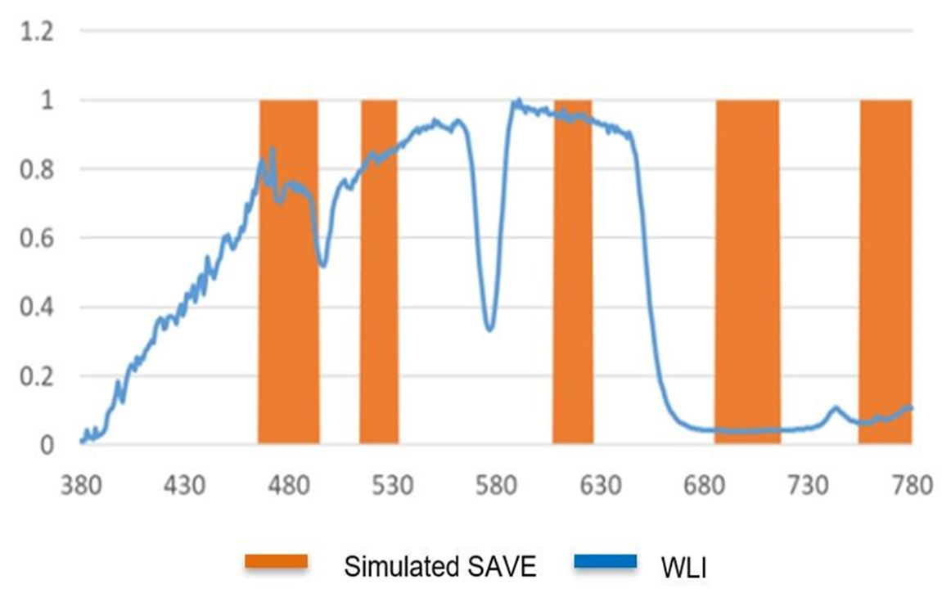
Continue..
Color difference of the simulated
and observed SAVE colors
The difference between the Simulated SAVE and WLI

Slide 9
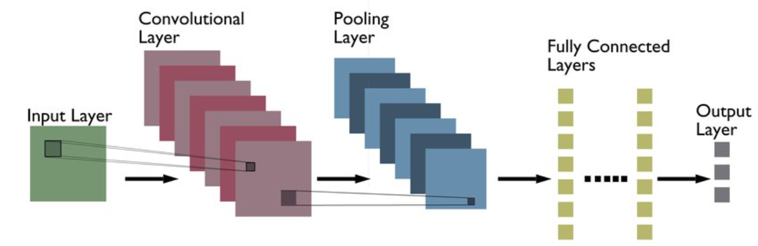
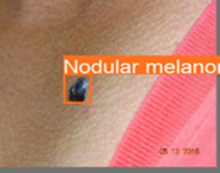
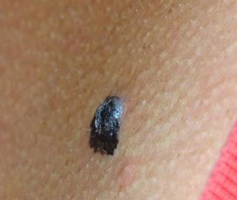
Convolutional Neural Network (CNN)

Slide 10
Dataset
No | Classification | Clinical image | Dermoscopic image | Clouse up image
1 | Acral lentiginous melanoma | 101 | 11 | 230
2 | Melanoma in Situ | 135 | 19 | 20
3 | Nodular Melanoma | 25 | 15 | 60
4 | Superficial Spreading Melanoma | 184 | 34 | 35
The dataset used are combination of the Buddhist Dalin Tzu Chi General Hospital data set and ISIC data set
Skin Lesion analysis to find melanoma
878 WLI images
Labeled according to melanoma classification
No | Classification | Train | Validation | Test
1 | Acral lentiginous melanoma | 287 | 29 | 26
2 | Melanoma in Situ | 164 | 11 | 8
3 | Nodular Melanoma | 84 | 10 | 6
4 | Superficial Spreading Melanoma | 223 | 20 | 10

Slide 11
Data Augmentation
Model Compilation and Training Parameters
Data augmentation is proposed to inflate the sample size, which is unstable classes avoiding biased predictions due to class imbalance issues
Following data augmentation used to increase dataset variability:
Clockwise and Anti-clockwise : 90 degree
Shear Horizontal and Vertical : ± 10
Batch size: 16
Training epochs: 600
Learning rate: 0.05
Optimizer : Adam
Metric : Accuracy

Slide 12
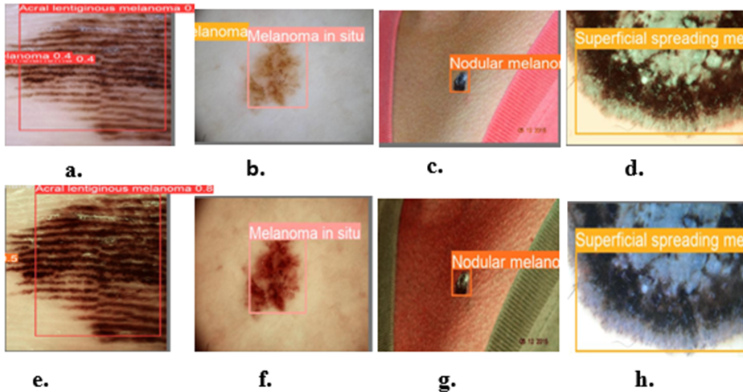
Result & Discussion
The YOLO versions are trained with datasets: WLI and SAVE
The prediction results of skin cancer in this study (a, e) ALM, WLI and SAVE, (b, f) MIS WLI and SAVE, (c,g) NM WLI and SAVE, (d,h) SSM SAVE and WLI respectively

Slide 13
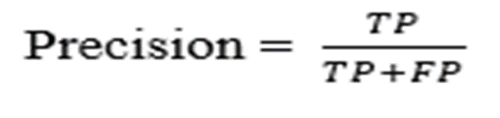
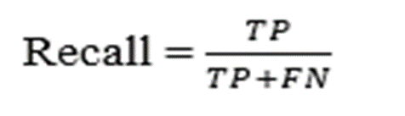
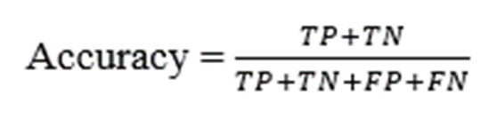

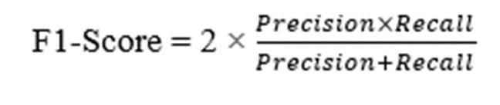
Results of YOLOv5
Architecture | Model | Classification | Precision | Recall | mAP50 | mAP50-95 | Accuracy
YOLOv5-n | WLI | ALM | 0.865 | 0.875 | 0.966 | 0.6 | 0.98
 |  | MIS | 0.78 | 0.545 | 0.597 | 0.323
 |  | NM | 0.732 | 0.9 | 0.932 | 0.679
 |  | SSM | 0.784 | 0.542 | 0.612 | 0.33
 | SAVE | ALM | 0.919 | 0.812 | 0.903 | 0.551 | 0.96
 |  | MIS | 0.551 | 0.455 | 0.481 | 0.223
 |  | NM | 0.84 | 0.8 | 0.842 | 0.60
 |  | SSM | 0.669 | 0.625 | 0.598 | 0.299

Slide 14
Results of YOLOv8
Architecture | Model | Classification | Precision | Recall | mAP50 | mAP50-95 | Accuracy
YOLOv8-n | WLI | ALM | 0.938 | 0.95 | 0.965 | 0.562 | 0.96
 |  | MIS | 0.685 | 0.545 | 0.608 | 0.294
 |  | NM | 0.867 | 0.9 | 0.932 | 0.62
 |  | SSM | 0.882 | 0.623 | 0.725 | 0.419
 | SAVE | ALM | 0.946 | 0.812 | 0.957 | 0.55 | 0.98
 |  | MIS | 0.859 | 0.555 | 0.7 | 0.286
 |  | NM | 0.851 | 0.9 | 0.891 | 0.631
 |  | SSM | 0.875 | 0.582 | 0.639 | 0.338

Slide 15
Results of YOLOv9
Architecture | Model | Classification | Precision | Recall | mAP50 | mAP50-95 | Accuracy
YOLOv9-gelan | WLI | ALM | 0.657 | 0.846 | 0.814 | 0.508 | 0.83
 |  | MIS | 0.949 | 0.667 | 0.826 | 0.46
 |  | NM | 0.882 | 0.231 | 0.533 | 0.33
 |  | SSM | 0.737 | 0.676 | 0.776 | 0.472
 | SAVE | ALM | 0.849 | 1 | 0.995 | 0.4 | 0.87
 |  | MIS | 0.798 | 0.607 | 0.749 | 0.45
 |  | NM | 0.755 | 0.571 | 0.765 | 0.416
 |  | SSM | 0.73 | 0.484 | 0.579 | 0.31

Slide 16
Evaluation of different models
Framework | Model | Precision | Recall | F1-Score | mAP
YOLOv5 | WLI | 0.804 | 0.707 | 0.751 | 0.797
 | SAVE | 0.799 | 0.829 | 0.810 | 0.819
YOLOv8 | WLI | 0.843 | 0.755 | 0.795 | 0.807
 | SAVE | 0.904 | 0.71 | 0.794 | 0.801
YOLOv9 | WLI | 0.806 | 0.605 | 0.65 | 0.737
 | SAVE | 0.783 | 0.666 | 0.71 | 0.775
YOLO-NAS | WLI | 0.733 | 0.541 | 0.623 | 0.659
 | SAVE | 0.731 | 0.665 | 0.69 | 0.69
Roboflow3.0 | WLI | 0.719 | 0.643 | 0.675 | 0.66
 | SAVE | 0.781 | 0.613 | 0.68 | 0.68
YOLOv8 precision : 90% with SAVE
YOLOv5 higher recall

Slide 17
Conclusions and Future scope
YOLO based DL assisting the solution for dermatologists with the diagnosis of skin lesions, especially for early melanoma detection
YOLO with HSI-SAVE technique, improved the accuracy of YOLOv8- 98% and ALM is 94% and SSM, 87%
Class imbalance
New augmentation techniques for regularization
Larger dataset including more of other skin diseases and different stages of cancer

Slide 18
Thank you for your kind attention!

